Slide 1
Mathematical Foundations for ML (10-606):
Overview & Preliminaries
Bryan Wilder
bwilder@cmu.edu
* Slides borrowed from prior offerings by Professors M. Gormley, P. Virtue, G. Gordon, & H. Heidari.

Slide 2
Course Overview
Goals:
A formal presentation of mathematics needed to understand Machine Learning
motivated by (carefully chosen) real-world problems that arise in ML applications,
where the broader picture of how those problems arise is treated somewhat informally.
Audience:
students wishing to prepare for future coursework in Machine Learning

Slide 3
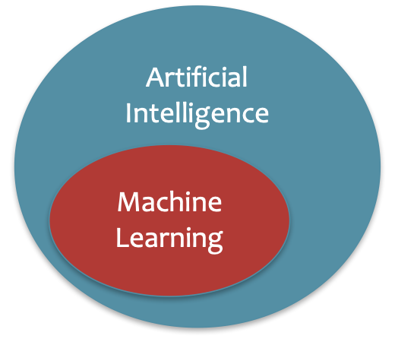
What is Artificial Intelligence?
The basic goal of AI is to develop intelligent machines.
Intelligence is the computational part of the ability to achieve goals in the world.
This consists of many sub-goals:
Perception
Reasoning
Control/Motion/Manipulation
Planning
Communication
Creativity
Learning
…
Notes:
http://www-formal.stanford.edu/jmc/whatisai/whatisai.html

Slide 4
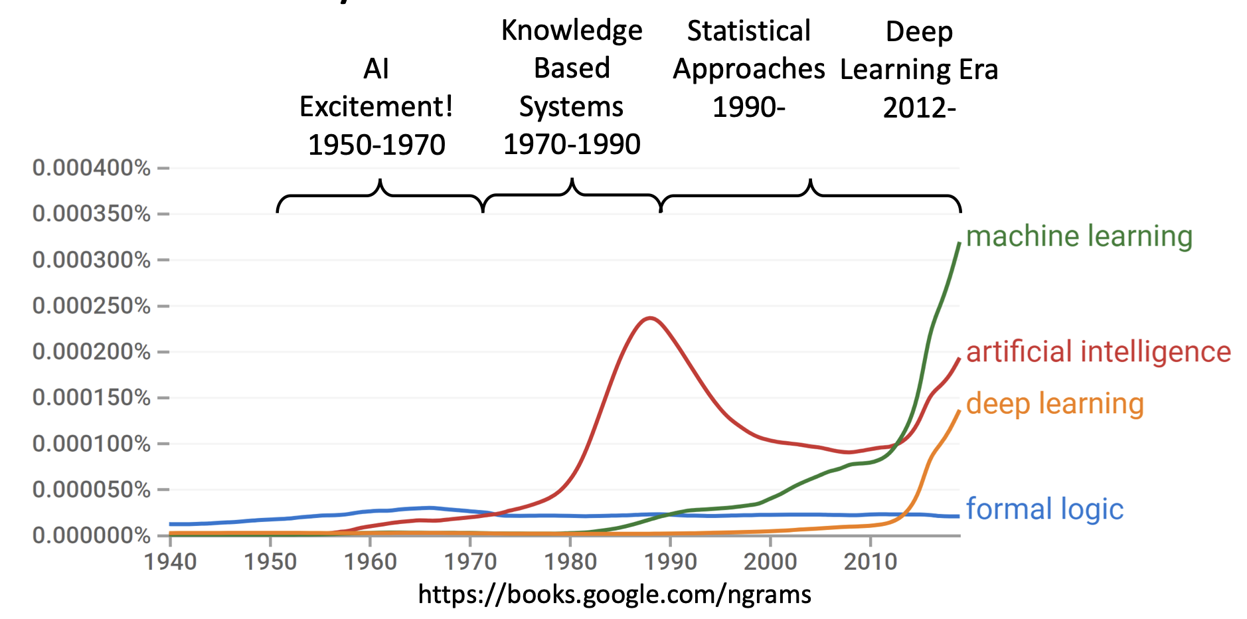
A brief History of AI

Slide 5
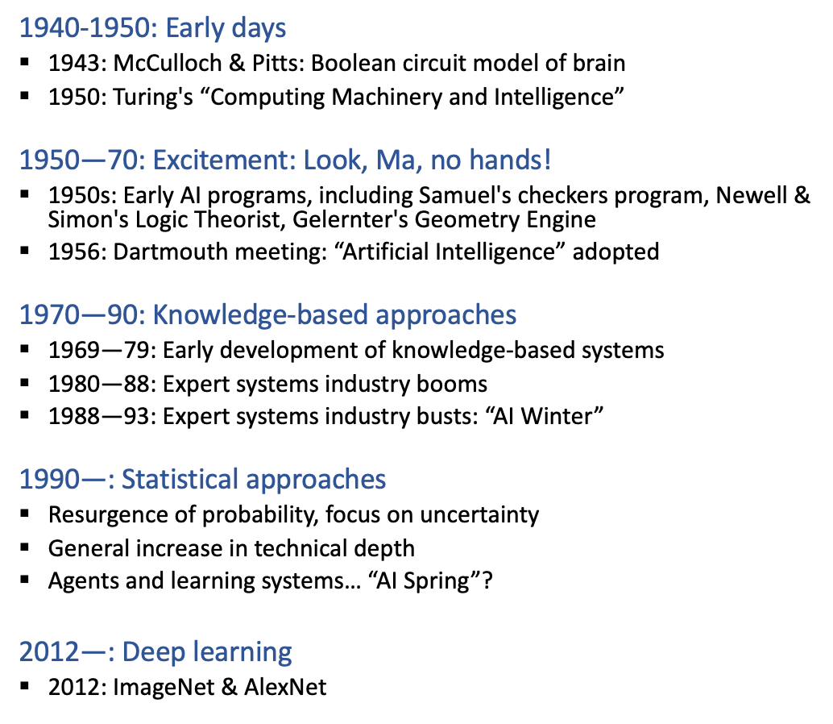
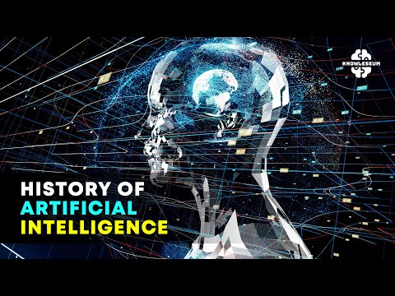
A brief History of AI
Now: LLM-mania

Slide 6
What is Machine Learning?
Machine learning aims to design algorithms that automatically extract valuable information from data by modeling the data-generating process.
Data
Model
Learning

Slide 7
What is Machine Learning?
Machine learning aims to design algorithms that automatically extract valuable information from data by modeling the data-generating process.
Data → Vectors, Matrices
Model → Probability
Learning → Optimization

Slide 8
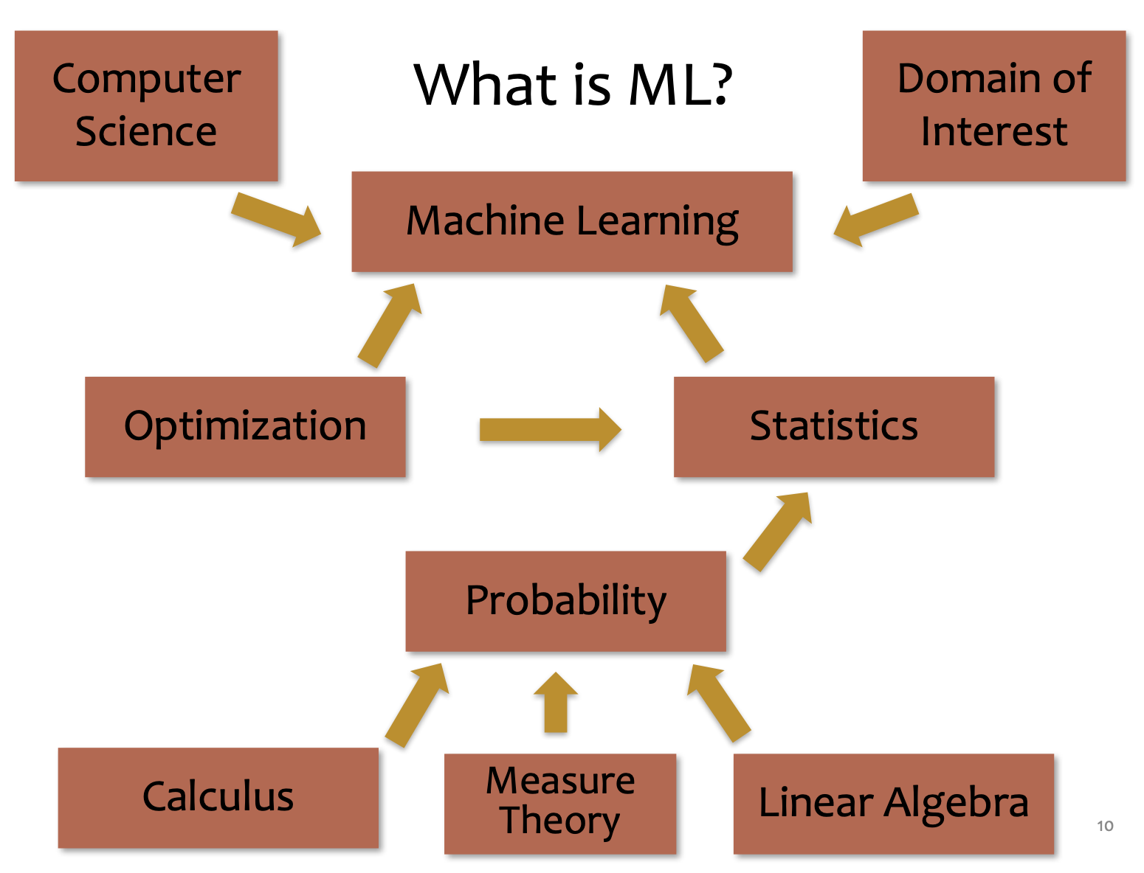
What is Machine Learning?

Slide 9
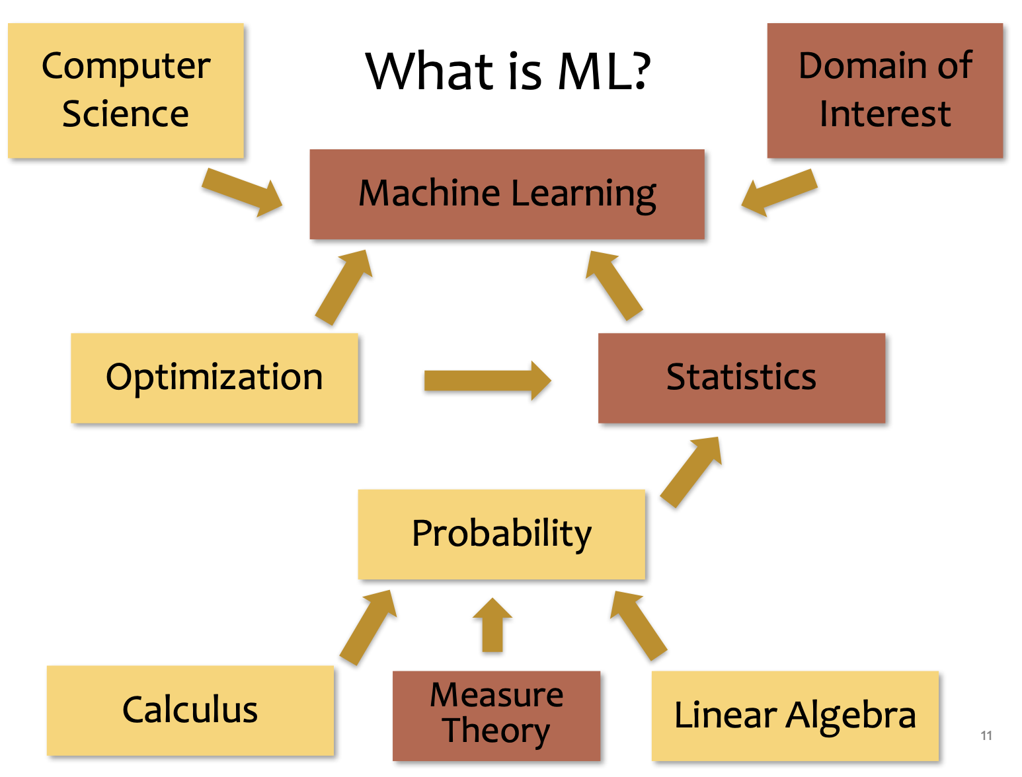
What is Machine Learning?

Slide 10
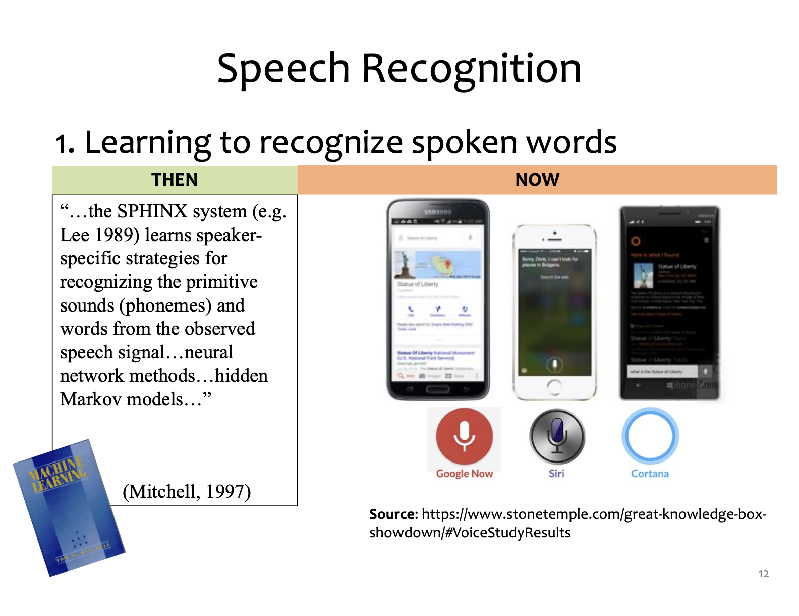
Applications

Slide 11
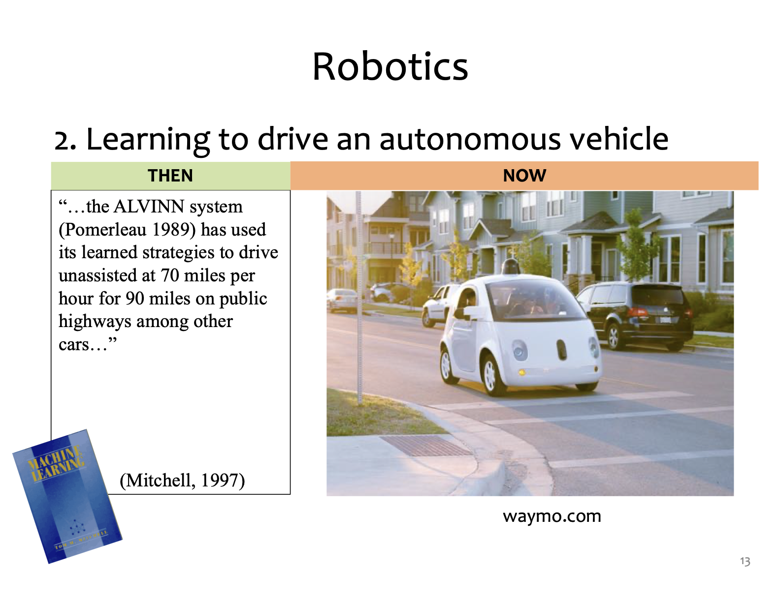
Applications

Slide 12
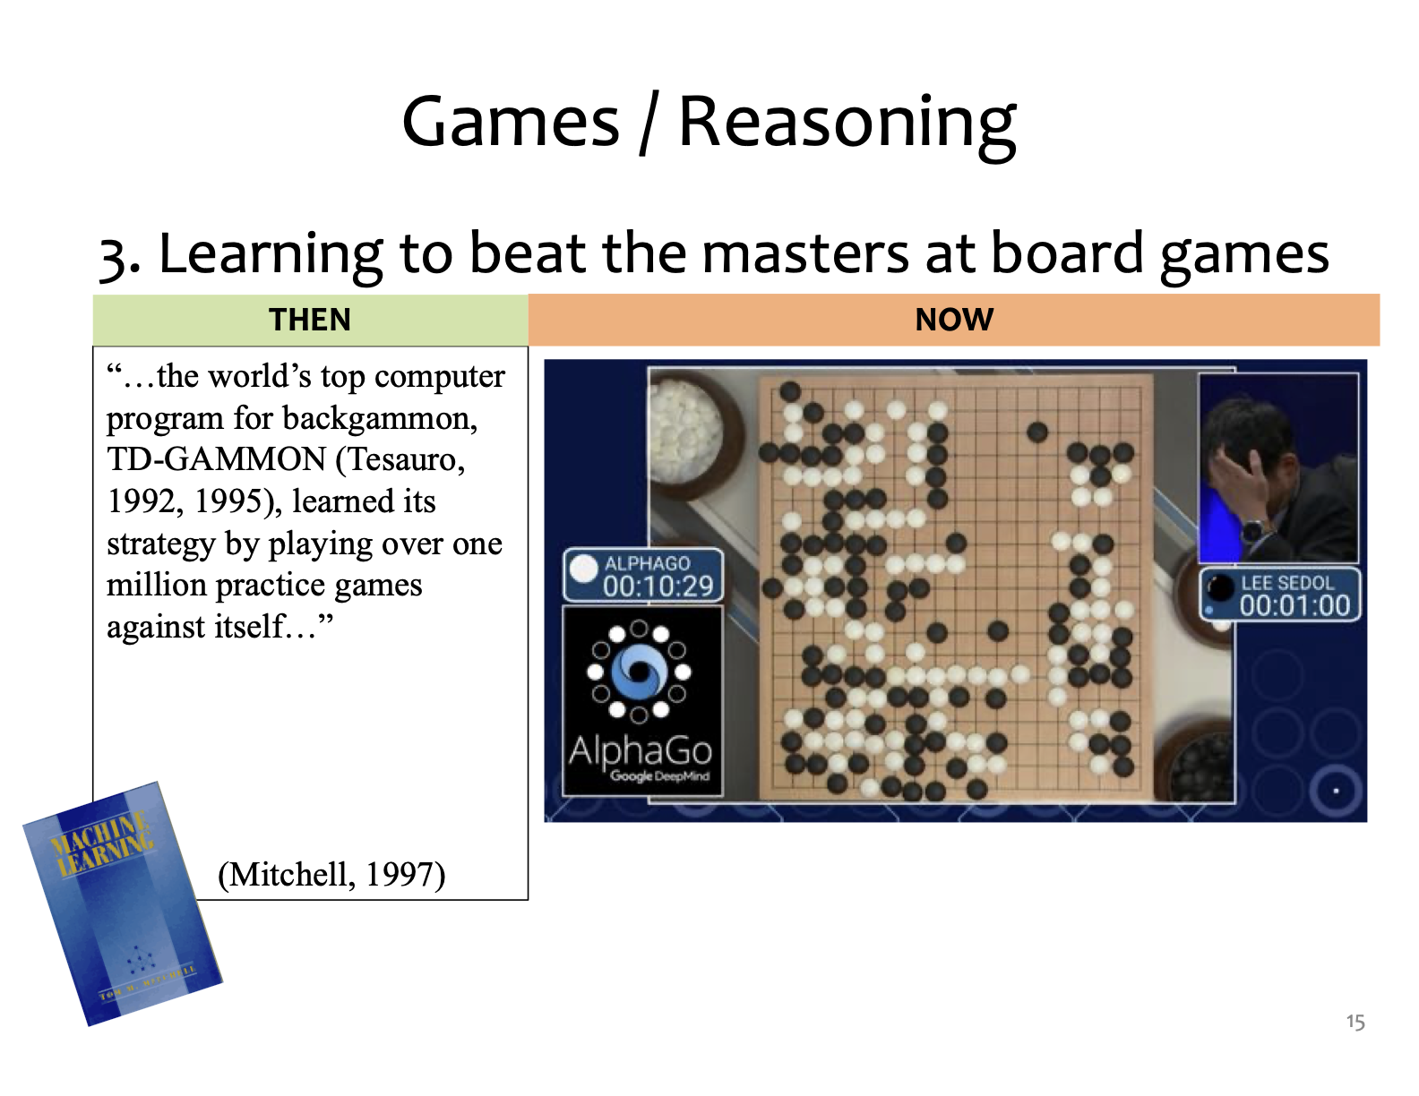
Applications

Slide 13
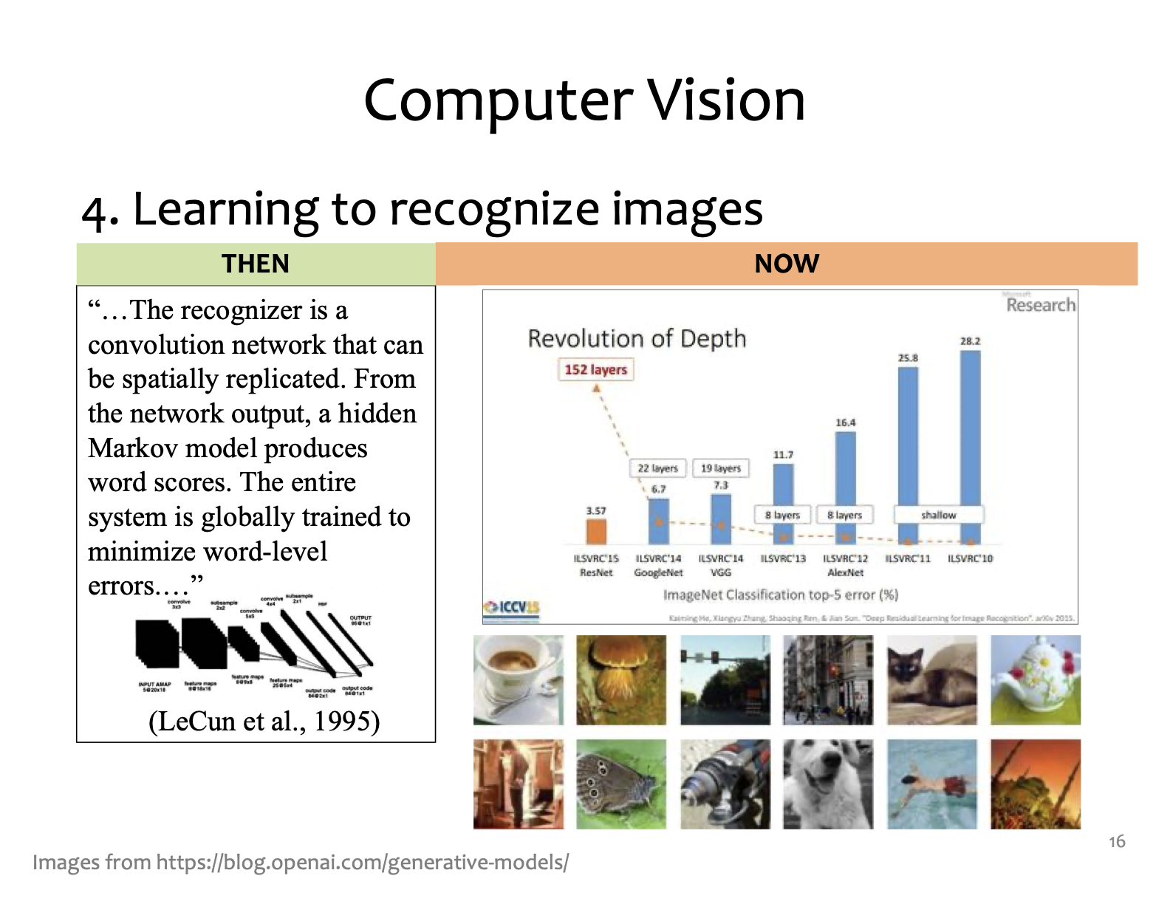
Applications

Slide 14
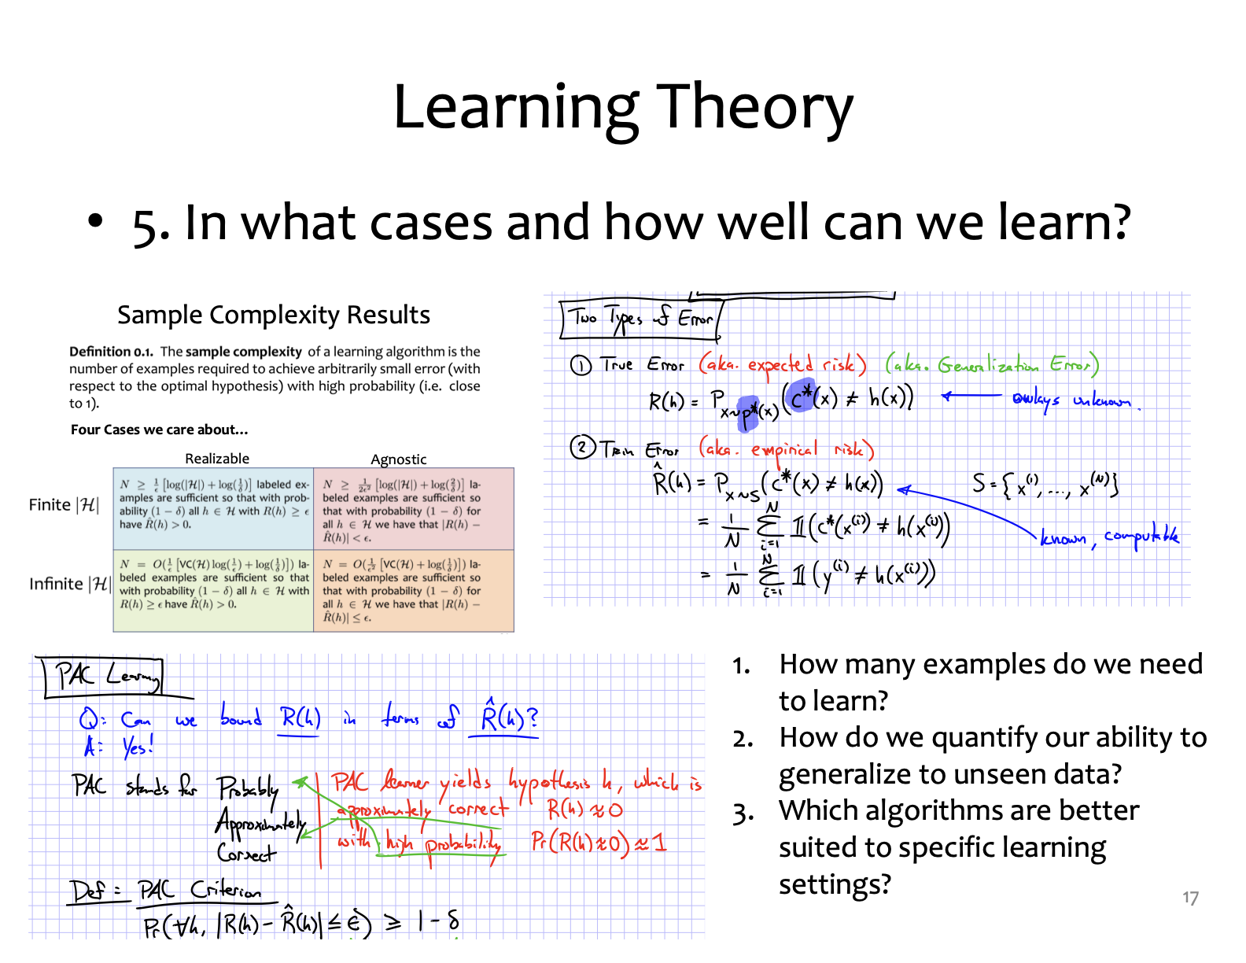
Foundation

Slide 15
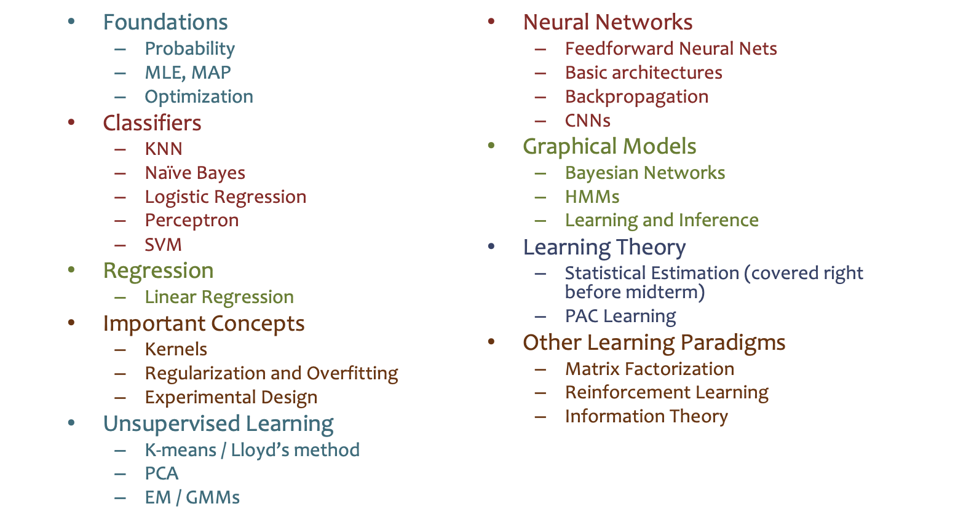
Topics Covered in an ML Course (e.g., 10-601)

Slide 16
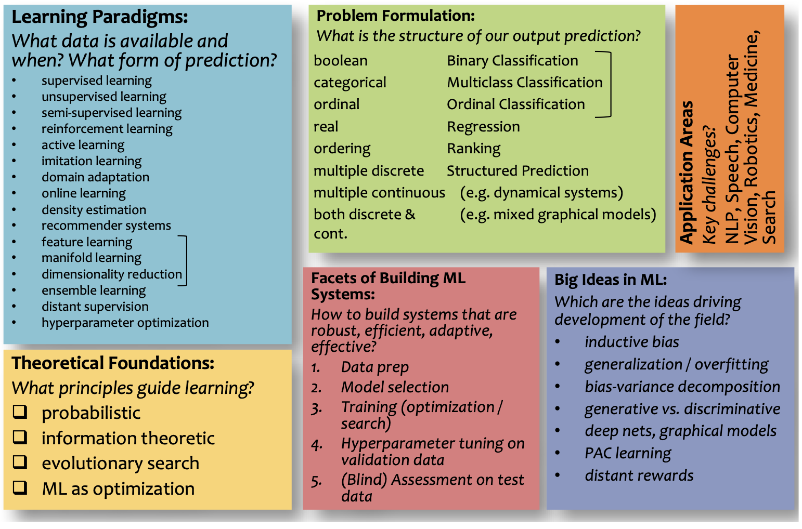
Big Picture

Slide 17
Why Math for ML (10-606)?
To understand A, we need B:
A | B
Training a vision model with backpropagation | Multivariate calculus: gradients Probability and statistics: stochastic gradient descent
Recommendation systems | Linear algebra: matrix factorizations Calculus: matrix differentials
Fine-tuning LLMs with LoRA | Linear algebra: rank of a matrix, low-rank updates
Principal component analysis | Singular value decomposition of a matrix

Slide 18
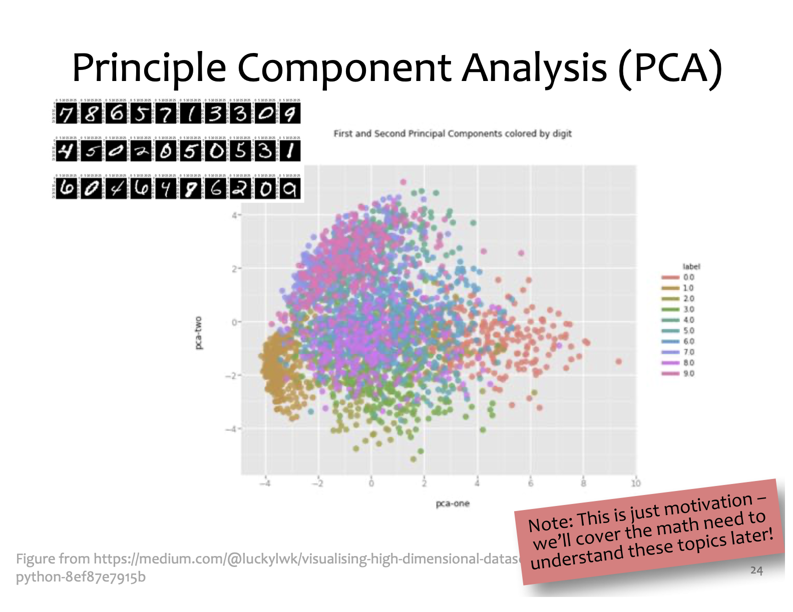
Why Math for ML (10-606)?
Notes:
dimensionality reduction, using principal component analysis: the key objective is to find a compact, lower-dimensional representation of high-dimensional data

Slide 19
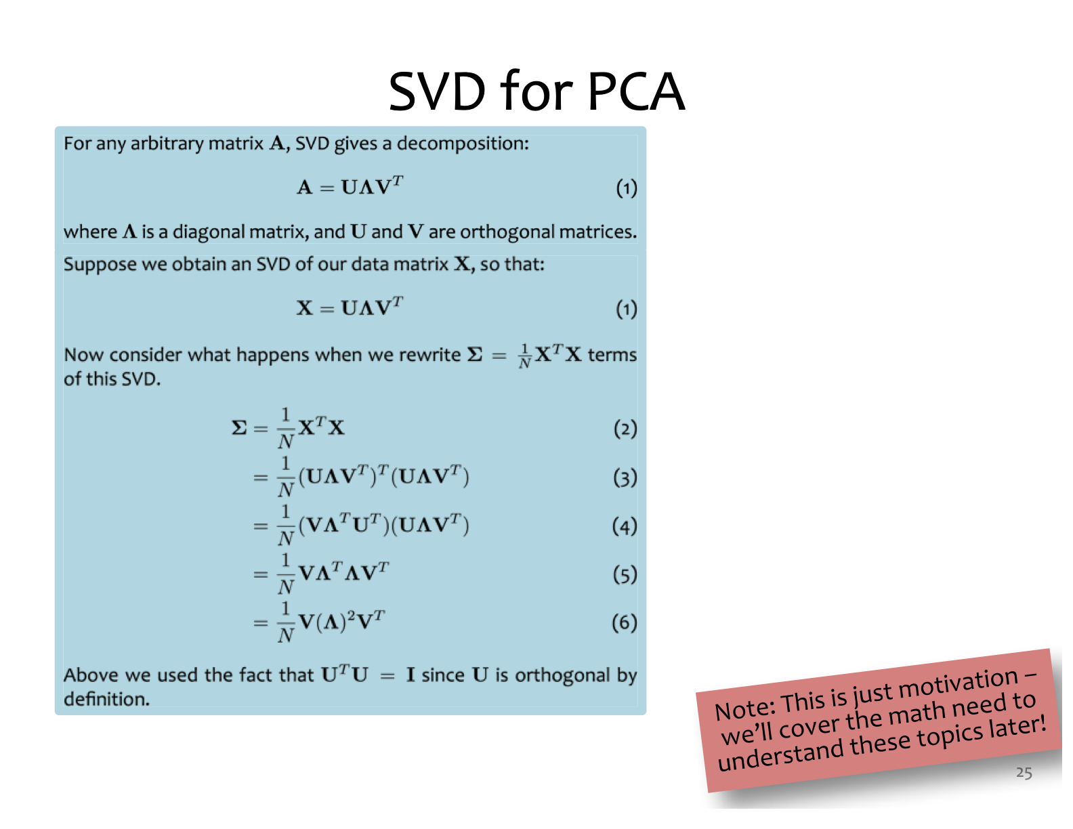
Why Math for ML (10-606)?
Notes:
SVD: Singular Value Decomposition

Slide 20
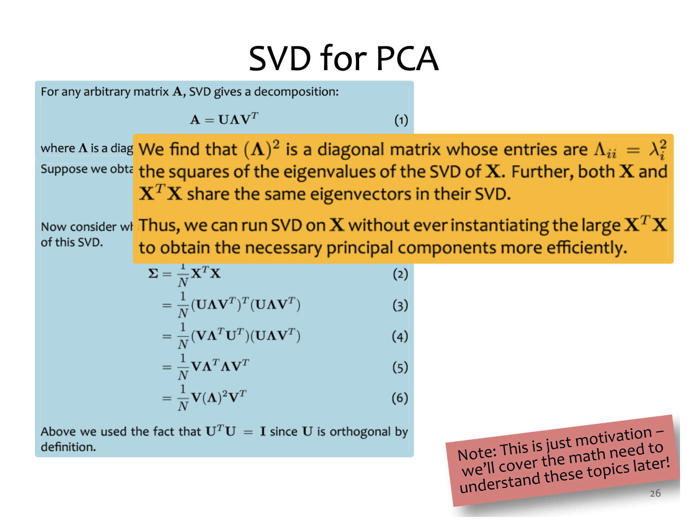
Why Math for ML (10-606)?

Slide 21
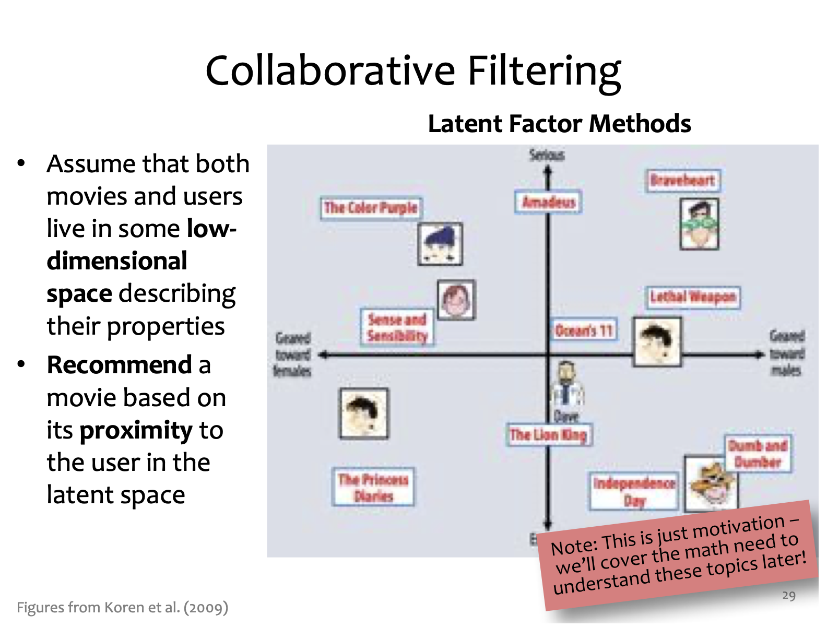
Why Math for ML (10-606)?

Slide 22
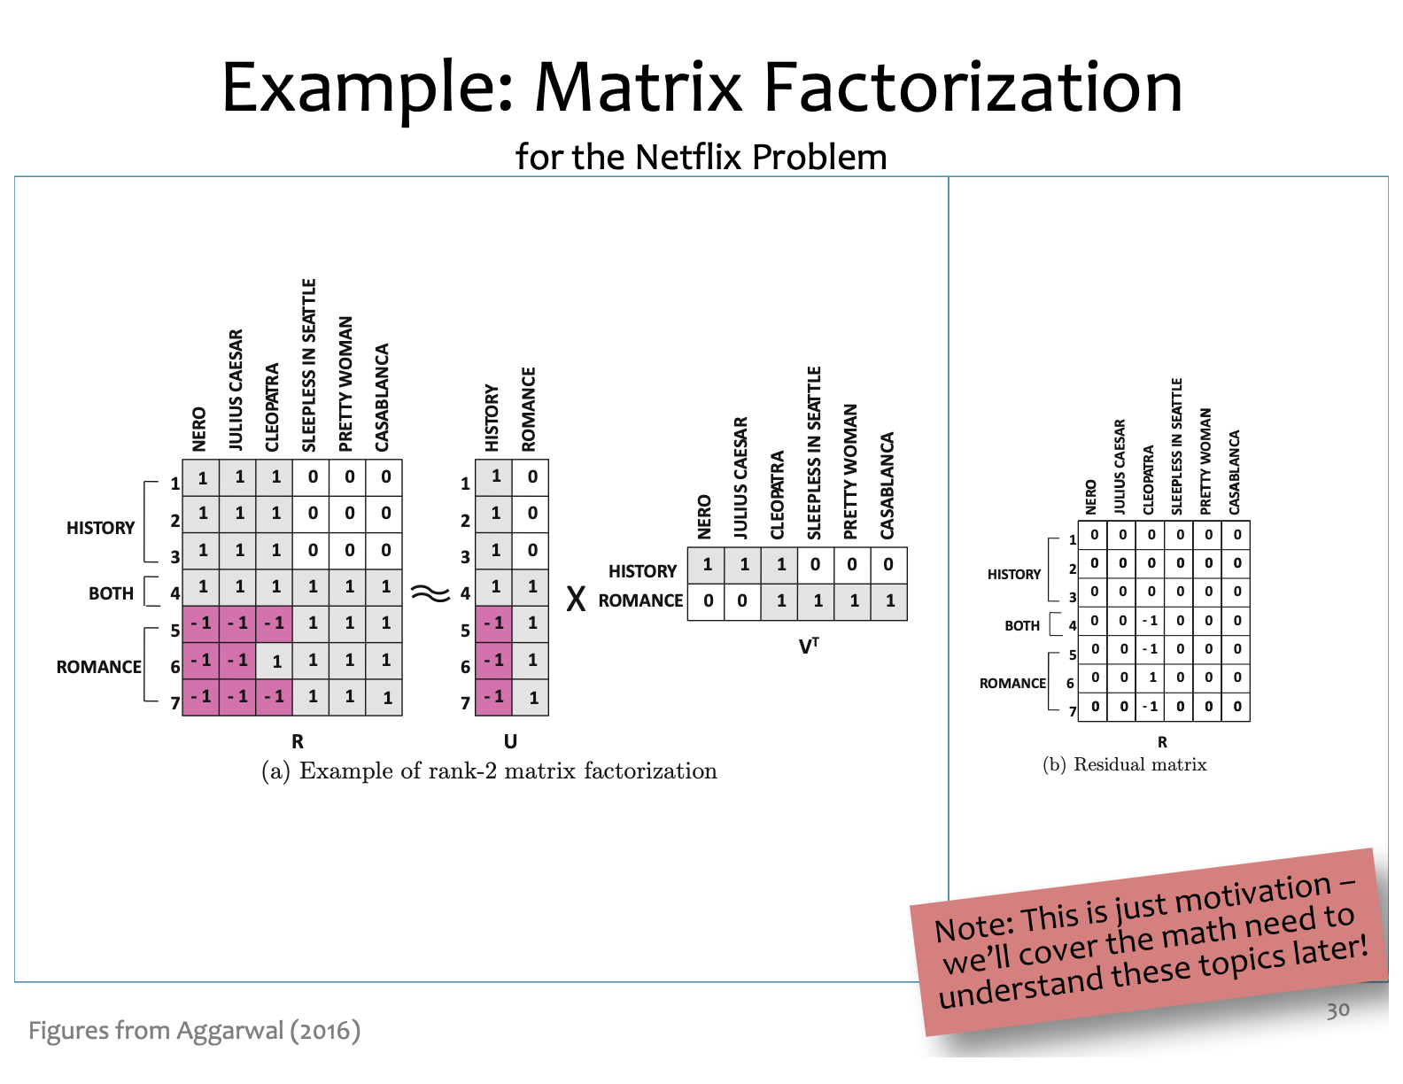
Why Math for ML (10-606)?

Slide 23
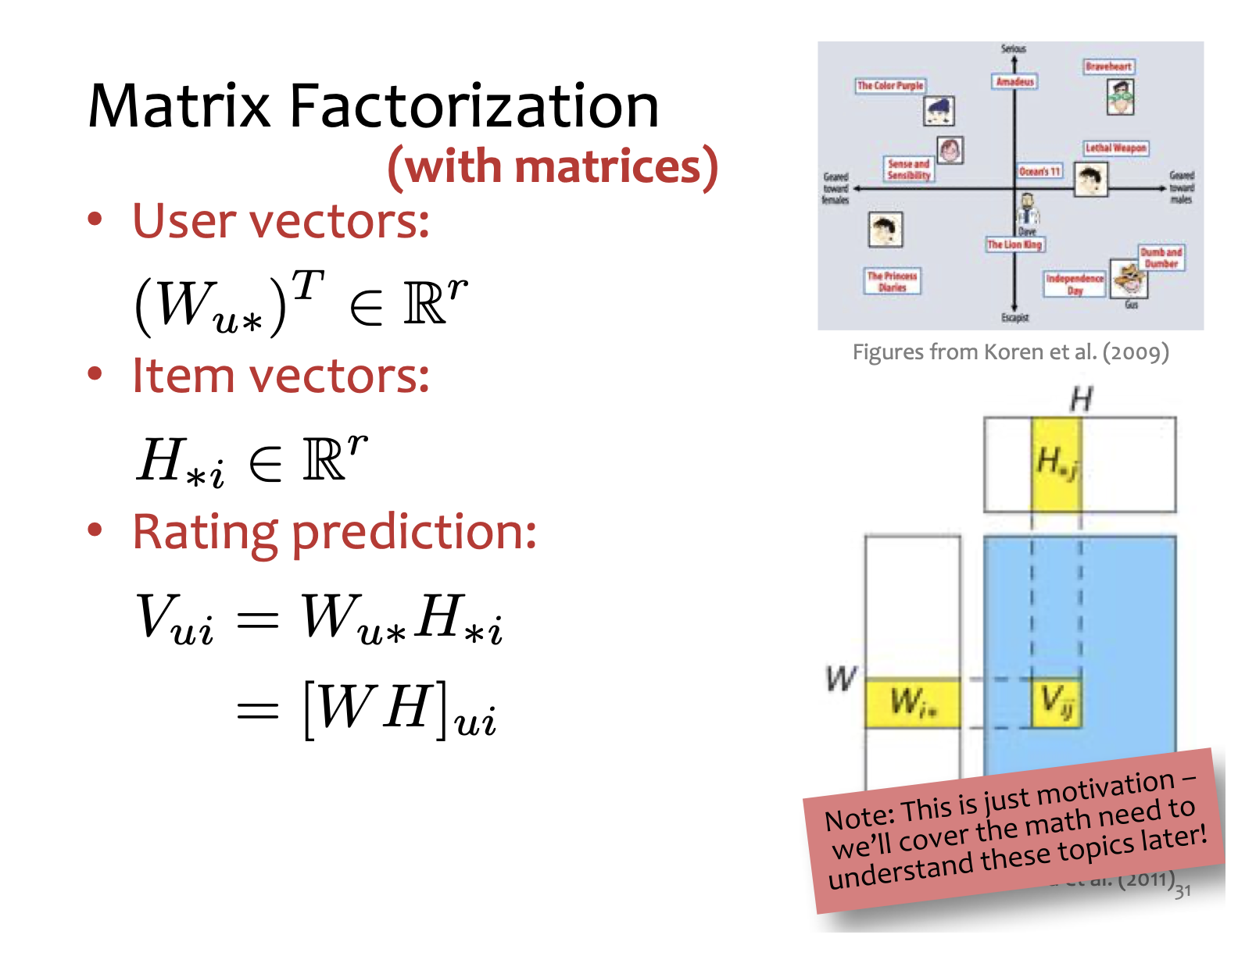
Why Math for ML (10-606)?

Slide 24
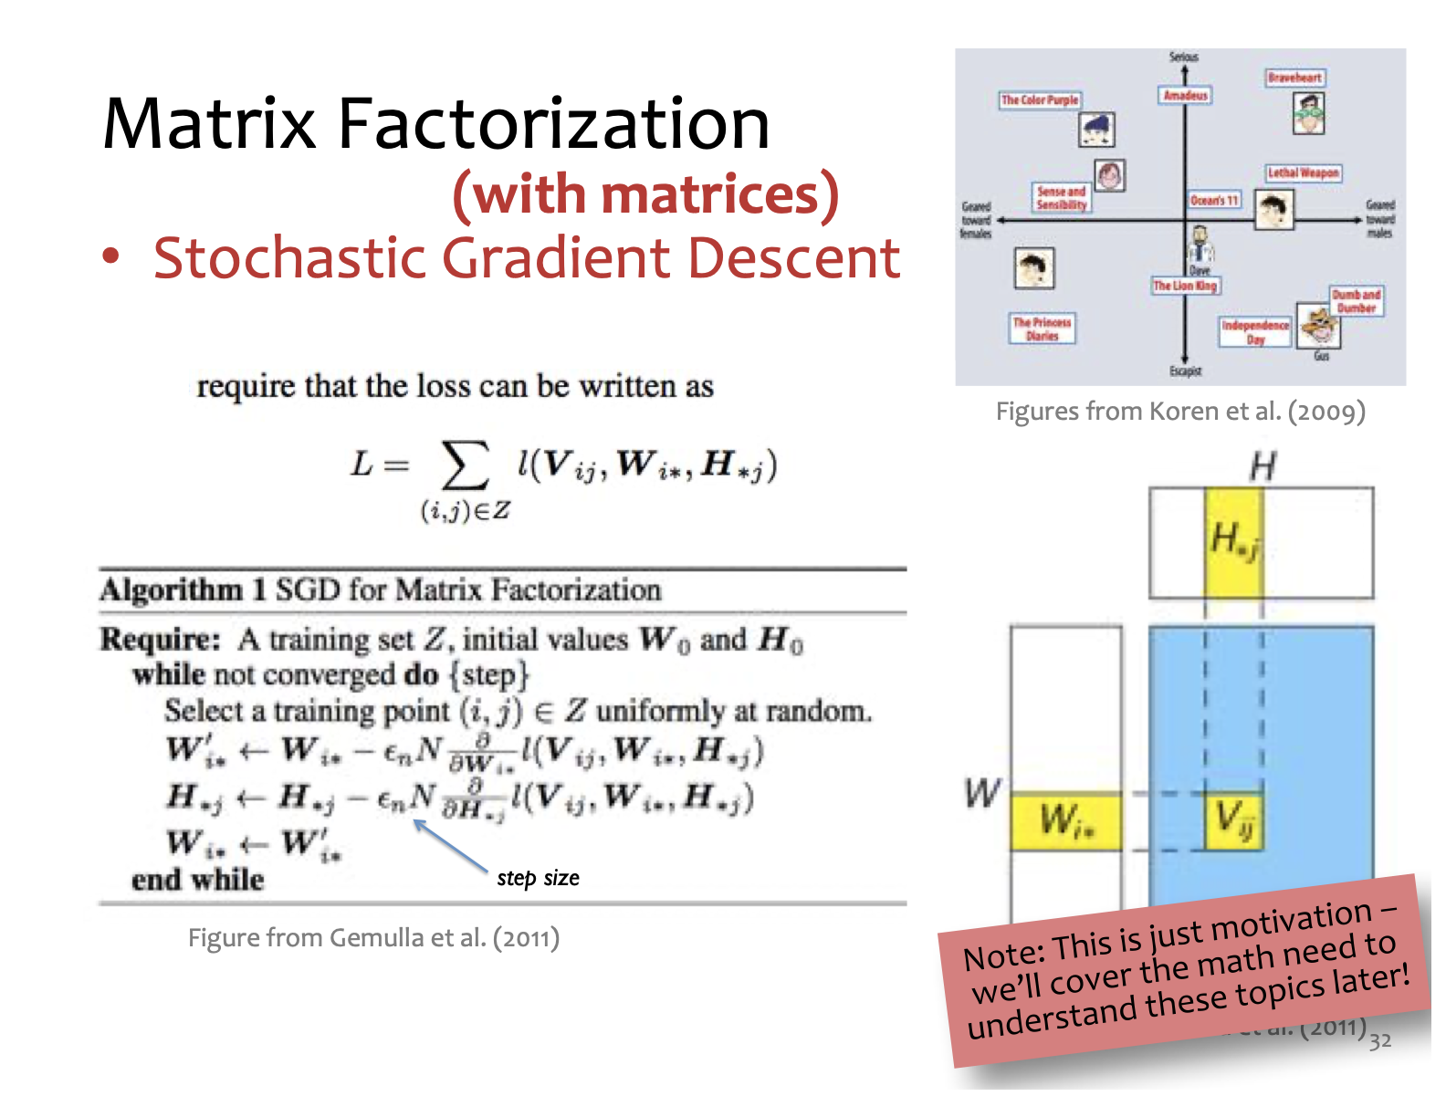
Why Math for ML (10-606)?

Slide 25
Why Math for ML (10-606)?
To understand A, we need B:
A | B
Training a vision model with backpropagation | Multivariate calculus: gradients Probability and statistics: stochastic gradient descent
Recommendation systems | Linear algebra: matrix factorizations Calculus: matrix differentials
Fine-tuning LLMs with LoRA | Linear algebra: rank of a matrix, low-rank updates
Principal component analysis | Singular value decomposition of a matrix
The core content for this course is the mathematics (Column B), but you will apply what you learn to real problems in machine learning (Column A)

Slide 26
Course website
https://github.com/bwilder0/10606-f2024
(Link also in canvas)
This is where we will maintain the class schedule, post lecture notes, etc. Also has the syllabus and policies.

Slide 27
Grading and policies
50%: Homeworks due each week (gradescope)
First one due Sunday!
50%: 3 in-person quizzes (schedule on course website)

Slide 28
Course structure
Monday/Wednesday: lecture with instructor
Friday: recitation with TA
Sunday EOD: homework due

Slide 29
Expected Background
You should be familiar with some of the following...
Calculus:
can take scalar derivatives
can solve scalar integrals
Linear Algebra:
know basic vector operations
seen matrix multiplication
Probability:
seen the basics: conditioning, Bayes Rule, etc.
Programming:
know some Python OR
have sufficient programming background to pick up the basics of Python

Slide 30
Preliminaries

Slide 31
Sets
Whiteboard
Set, element of, equality, subset
Example: Sets of sets
Enumeration and set builder notation
Union, intersection, difference, complement
Exercise: Set complement
Tuples and set product
Exercise: Set product
Python list/set comprehensions
Exercise: Set builder notation

